Slide 1
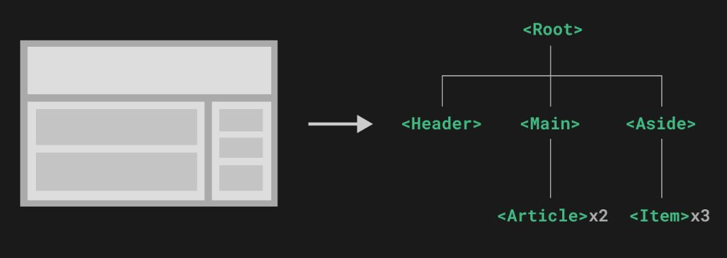
What is Component
Components allow us to split the UI into independent and reusable pieces, and think about each piece in isolation. It's common for an app to be organized into a tree of nested components.

Slide 2
Rahul
Sonam
Sumit
Jyoti
<div>
Rahul
Code 2
Code 3
</div>
<div>
Sonam
Code 2
Code 3
</div>
<div>
Sumit
Code 2
Code 3
</div>
<div>
Jyoti
Code 2
Code 3
</div>
Customer
<div>
Name
Code 2
Code 3
</div>
Rahul
Sonam
Sumit
Jyoti
<Customer name=‘Rahul’ />
<Customer name=‘Sonam’ />
<Customer name=‘Sumit’ />
<Customer name=‘Jyoti’ />

Slide 3
What is Vue Component
Vue components are written as a combination of JavaScript objects that manage the app's data and an HTML-based template syntax that maps to the underlying DOM structure.

Slide 4
What is Single File Component
Vue Single-File Components (SFC) a.k.a. *.vue files is a special file format that allows us to encapsulate the template(HTML), logic (JavaScript), and styling (CSS) of a Vue component in a single file.
Syntax:-
FileName.vue
<script> JavaScript </script>
<template> HTML </template>
<style> CSS </style>
Language Blocks

Slide 5
<template>
Each *.vue file can contain at most one top-level <template> block at a time.
Contents will be extracted and passed on to @vue/compiler-dom, pre-compiled into JavaScript render functions, and attached to the exported component as its render option.

Slide 6
<script>
Each *.vue file can contain at most one <script> block at a time (excluding <script setup>).
The script is executed as an ES Module.
The default export should be a Vue component options object, either as a plain object or as the return value of defineComponent.
Example:-
<script>
<script lang = “ts”>
<script setup>

Slide 7
<style>
A single *.vue file can contain multiple <style> tags.
A <style> tag can have scoped or module attributes to help encapsulate the styles to the current component. Multiple <style> tags with different encapsulation modes can be mixed in the same component.
Example:-
<style>
<style scoped>
<style lang = “scss”>

Slide 8
Src Import
If you prefer splitting up your *.vue components into multiple files, you can use the src attribute to import an external file for a language block.
It’s Relative paths need to start with ./
<template src="./template.html"></template>
<style src="./style.css"></style>
<script src="./script.js"></script>

Slide 9
Defining a Component
FileName.vue
<script setup>
Imports
Properties
Methods
</script>
<template>
HTML Here we get access to Properties and Methods
Child Components which we have imported
</template>
<style scoped> CSS </style>
HelloWorld.vue
<script setup>
const msg = "Hello World"
</script>
<template>
<h1>{{ msg }}</h1>
</template>
<style scoped>
h1 { font-size: 2.6rem; }
</style>

Slide 10
Register & Use a Component
A Vue component needs to be "registered" so that Vue knows where to locate its implementation when it is encountered in a template. There are two ways to register components:-
Local
Global

Slide 11
Local
Local registration scopes the availability of the registered components to the current component only.
It makes the dependency relationship more explicit, and is more tree-shaking friendly.
Example:-
<script setup>
import ComponentA from './ComponentA.vue'
</script>
<template>
<ComponentA />
</template>

Slide 12
Component Naming Convention
We can use PascalCase names when registering components.
Example:- <HelloWorld />
A component registered as MyComponent can be referenced in the template via both <MyComponent> and <my-component>.

Slide 13
Global
We can make components available globally in the current Vue application using the app.component() method.
Globally registered components can be used in the template of any component within this application.
Example:-
main.js
import ComponentA from ‘./ComponentA.vue'
app.component('ComponentA', ComponentA)
app
.component('ComponentA', ComponentA)
.component('ComponentB', ComponentB)
.component('ComponentC', ComponentC)
Globally registered components can be used in the template of any component within this application.
<ComponentA/>
<ComponentB/>
<ComponentC/>

Slide 14
Disadvantages of Global Registration
Global registration prevents build systems from removing unused components (a.k.a "tree-shaking"). If you globally register a component but end up not using it anywhere in your app, it will still be included in the final bundle.
Global registration makes dependency relationships less explicit in large applications. It makes it difficult to locate a child component's implementation from a parent component using it. This can affect long-term maintainability similar to using too many global variables.

